Slide 1
Project ReServe
Created by Richard Compton, Selena Haidar, Kevin Kaminski, Kelly Kurkowski, Seth Logan, Elias Qumsieh, & Mary Shiner
Notes:
All introduce ourselves

Slide 2

Vision
The worst aspect of visiting a restaurant is waiting for a seat — but that problem can be remedied with engineering and hard work. Over the course of this semester, we will develop an application that will allow restaurants to manage their seating areas, allow customers to reserve seats, and notify them when it is ready for their arrival.
We are going to decimate the amount of time customers must wait for their table, while making this improvement simple for the restaurant to manage.
Notes:
Kelly has this slide DOWN PAT

Slide 3
Tools and Technologies
The following tools and technologies will be utilized during the creation of Project ReServe:
Slack
GitHub
Trello
Google Drive
Programming Languages include PHP, CSS, HTML, SQL, and C#.
Notes:
Kevin HAS GOT IT IN THE BAG

Slide 4

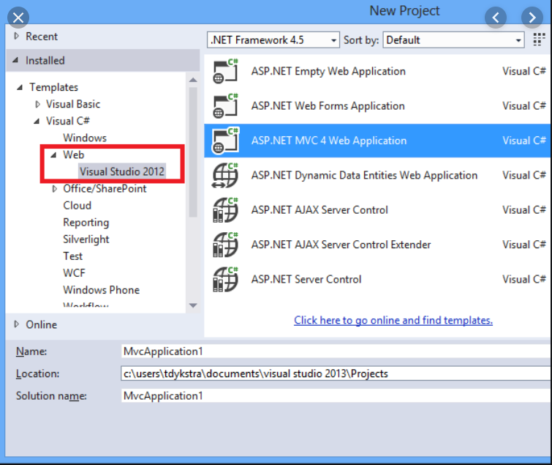
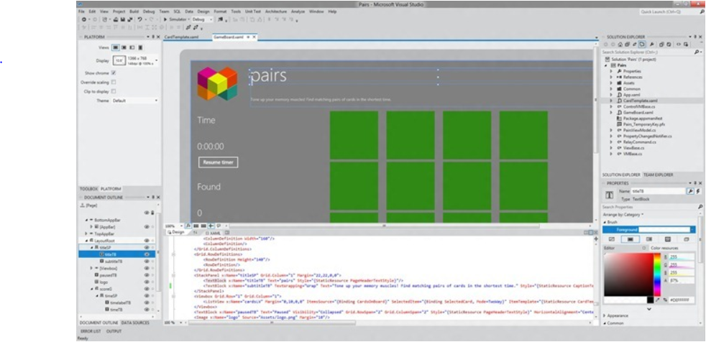
Development Environment and Server
Visual Studio 2019
C#
HTML / CSS / PHP
ASP.Net
Debugger
Design Interface
Easy to work with
Notes:
ELIAS IS DOING THIS? I THINK, YEAH, ELIAS CAN DO THIS

Slide 5
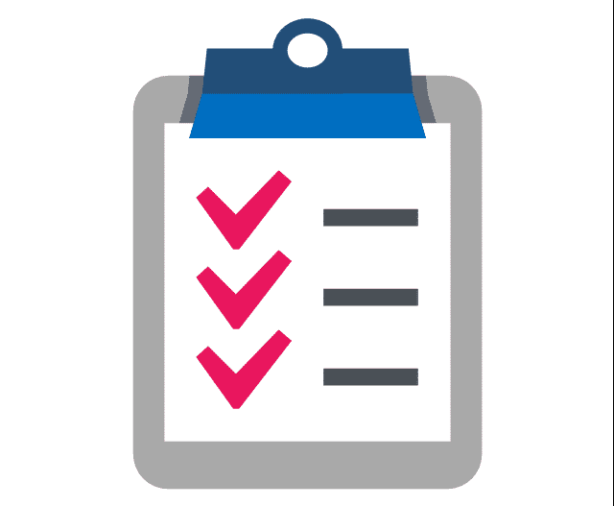
Restaurant/Customer Requirements
The restaurant will be able to manage the seating area from the project.
The restaurant will be able to estimate occupancy and wait time online.
The restaurant will be able to compute wait time intelligently based on average occupancy of each seating area.
The restaurant will be able to register their restaurant.
The customer will be able to reserve a table.
The customer/restaurant will be able to request/view the current wait time.
Notes:
Mary CAN DO IT BETTER

Slide 6
System Requirements
The system will be able to notify customers that their table is ready via SMS or the application.
The system will be able to register a restaurant.
The system will be able to configure seating areas.
The system will be able to manage the customer queue.
Notes:
Selena IS THE MASTER OF THE SYSTEM

Slide 7
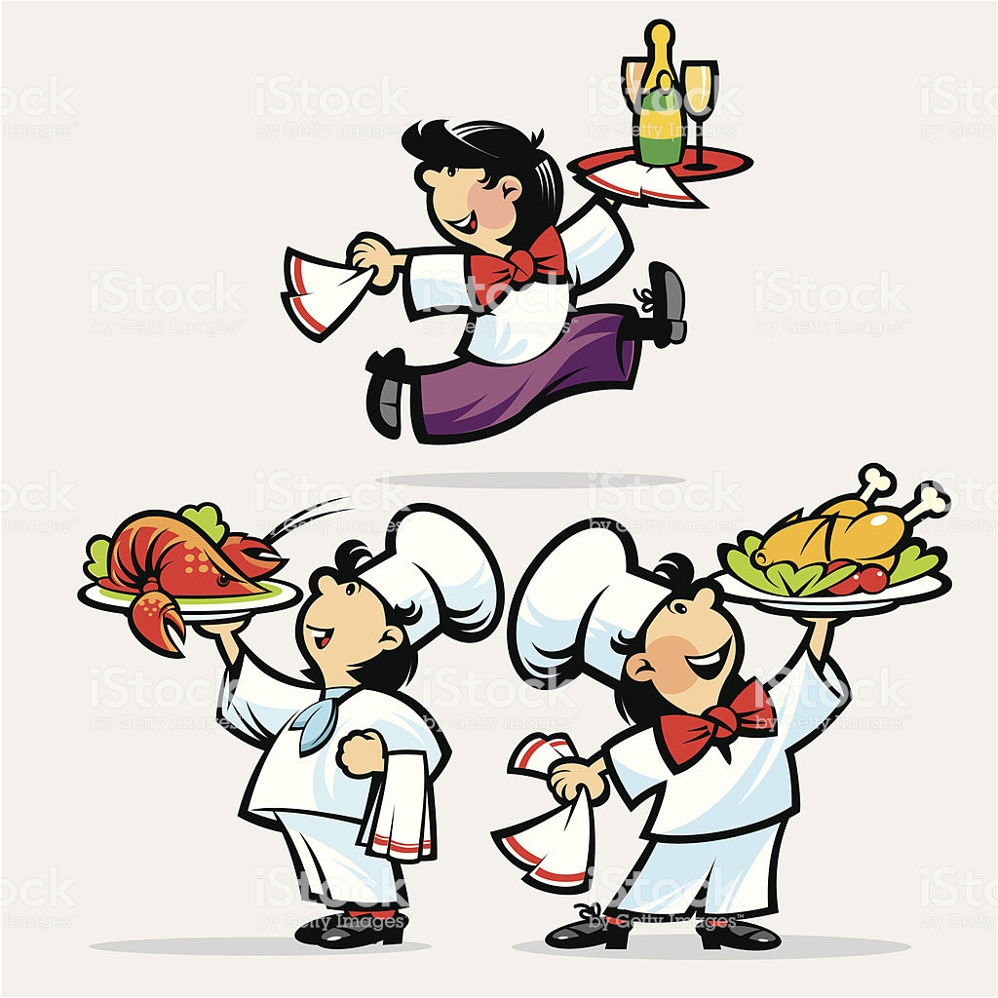
High Level User Stories
As a restaurant manager, I want to easily configure, manage and reconfigure a seating area.
As a restaurant manager, I want to quickly estimate my restaurant's average occupancy and wait time.
As a restaurant manager, I want to store my restaurant's information in a concise, clean medium
As a customer, I want to easily and accurately reserve a table.
As a customer, I want to swiftly know the current wait time.
Notes:
RJ

Slide 8

Looking Ahead: Sprint #1
We have already created a couple user stories for Sprint #1:
As a restaurant manager, I want to be able to login in to the system.
As a developer, I want a stable server environment to host the system.
Notes:
Elias is doing this?

Slide 9
Other Sprints
Sprint 2: Guest Information, Notification Process, and UI Skeleton
Sprint 3: Restaurant Registration, Basic Wait Time Calculations/Algorithms
Sprint 4: Restaurant Layout Configuration
Sprint 5+: Guest Reservations, Restaurant Reconfiguration, Restaurant Organization, Additional Guest Information, Mobile Optimization
Notes:
RJ, or someone else if they want

Slide 10
Potential Problems & Difficulties
Unfamiliarity with C#.
Rustiness with mobile development.
UI Configuration and Management.
! ? !
Notes:
RJ might be a problem with a high difficulty level

Slide 11
Are there any questions?
Notes:
IN UNISON

